Slide 1
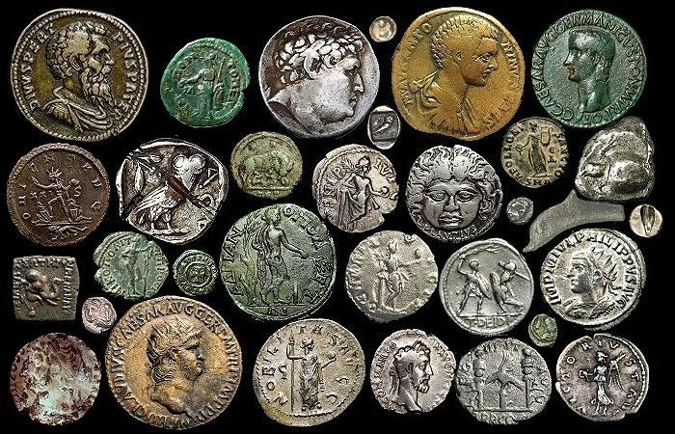
Foil Relief Coin Design
Ancient Coins

Slide 2
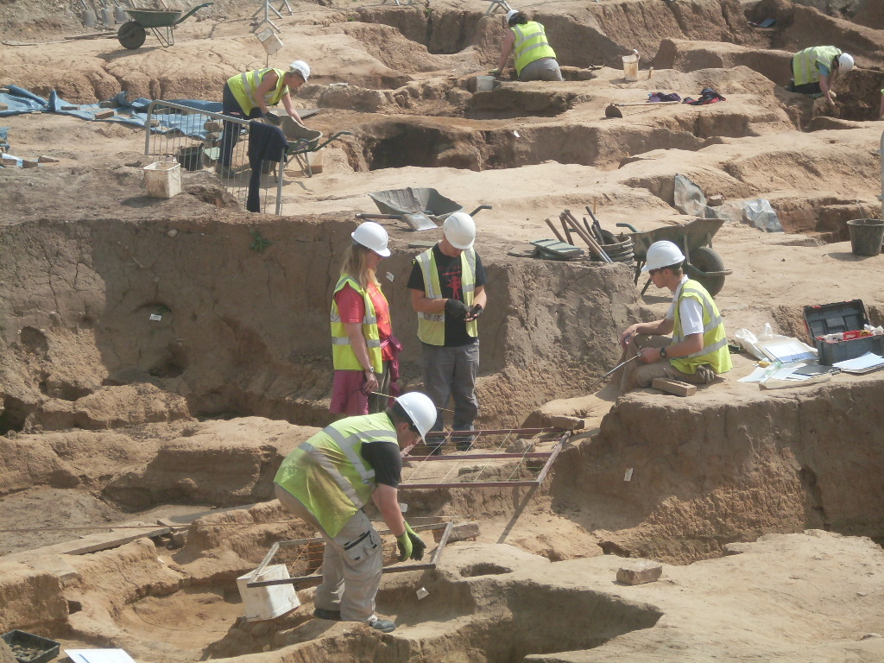
Archaeological Dig

Slide 3
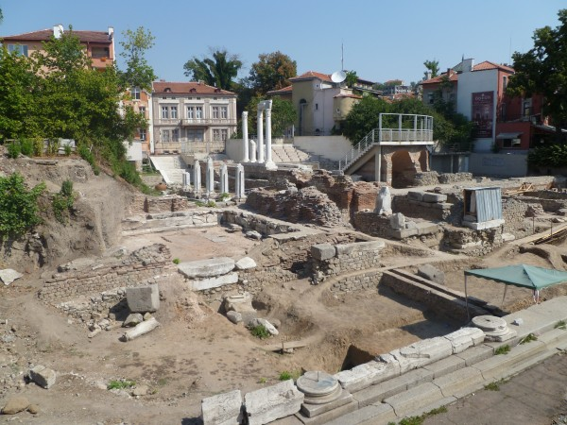
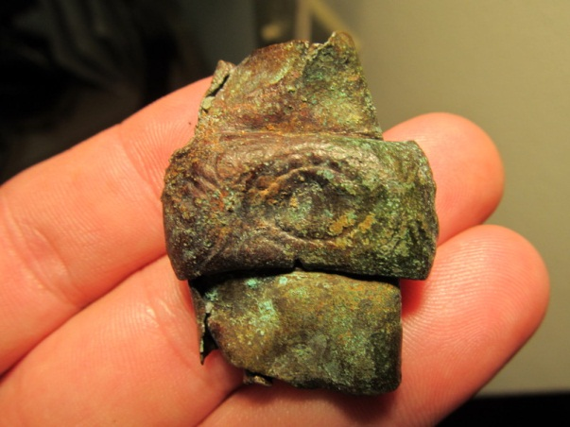
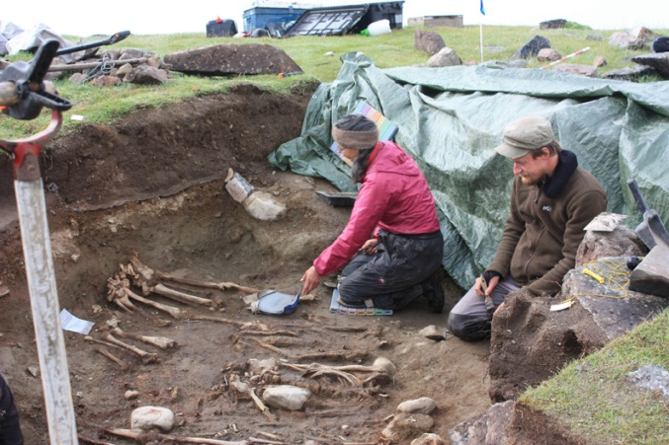
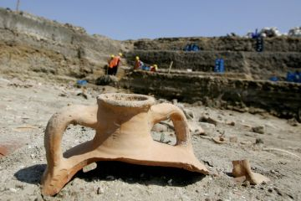
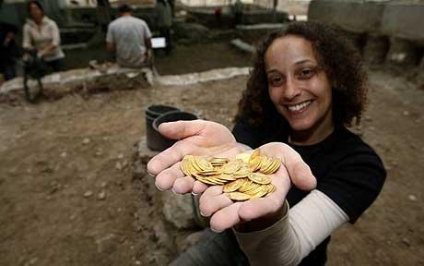
Finds…

Slide 4
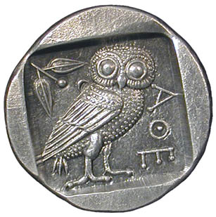
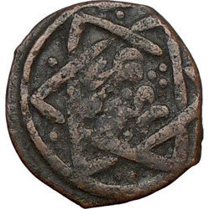
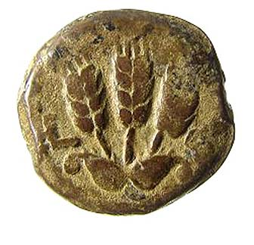
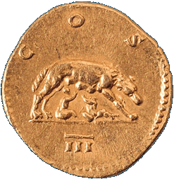
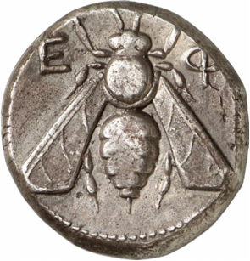
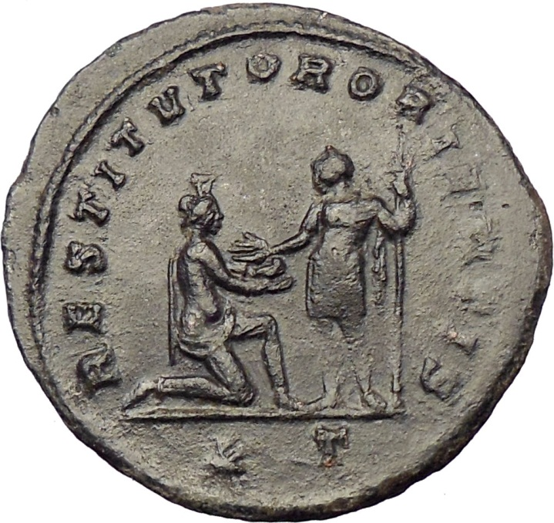
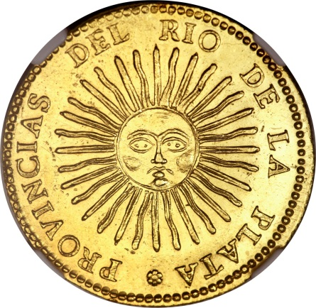

Slide 5
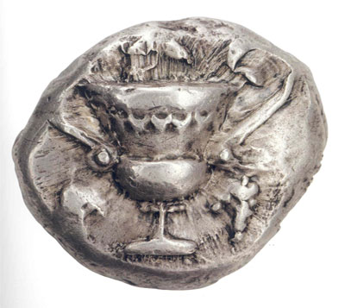
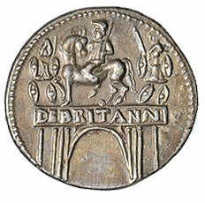
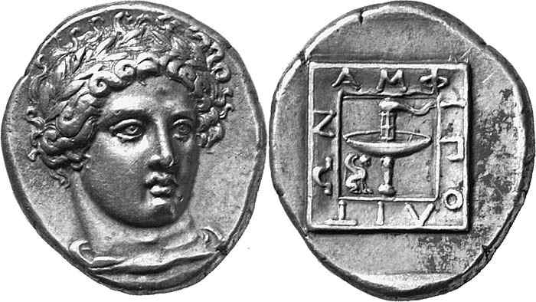
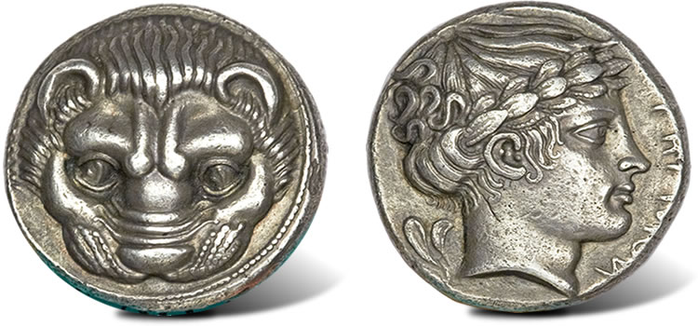
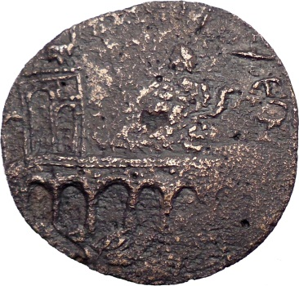
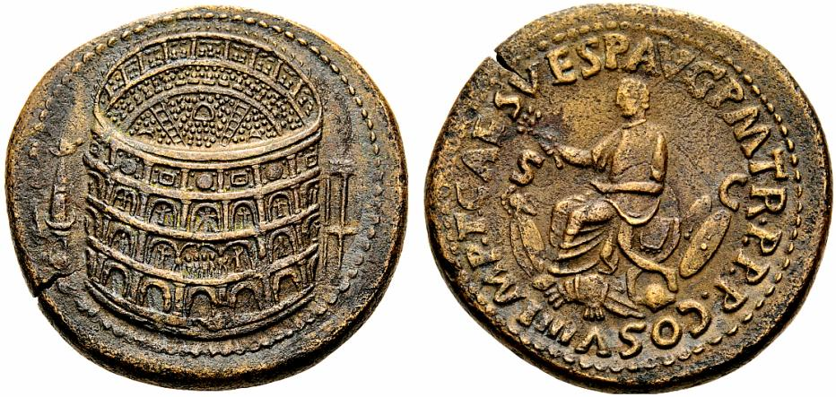
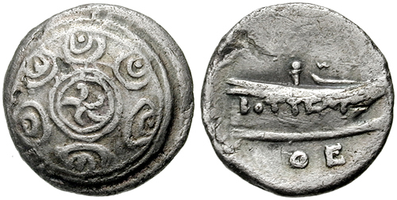
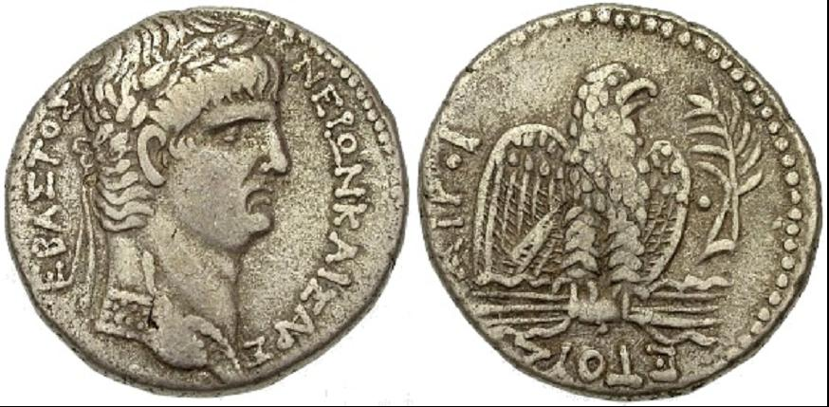

Slide 6
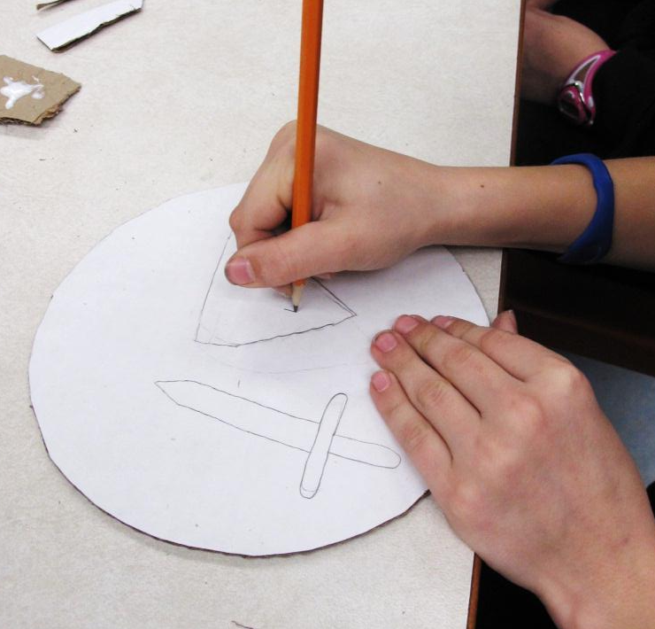
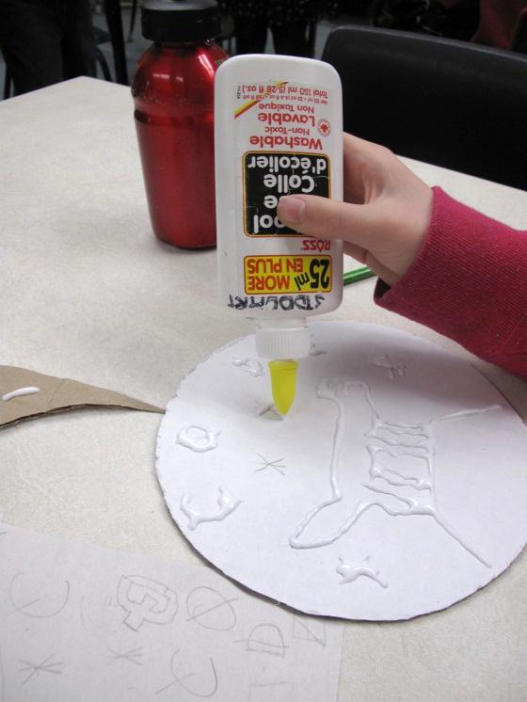
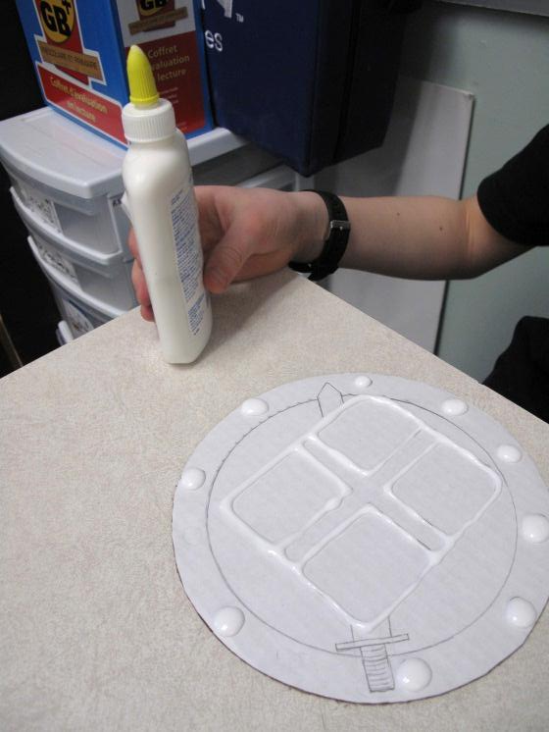
Last Time… Design & Relief

Slide 7
Foil…
Squeeze some white glue around the surface of your coin
Gently spread the glue with your finger to cover the entire surface
Quickly rinse your fingers
Lay a sheet of aluminum foil on top of the glued surface (SHINY or MATTE side up – you choose!)
GENTLY rub the foil to press and attach it securely around your relief design (With care… avoid rips)
Extra foil gets ‘wrapped’ around to the back of the coin

Slide 8
Inking Process…
At the Inking Station…
Lightly dip your brush in the ink
Apply a light, even layer (WASH) of ink over the surface of your coin
Take your coin back to your work space to dry
Wash your hands!

Slide 9
Polishing…
At your desk…
With a black square of felt, use a LIGHT, CIRCULAR motion to polish your coin design
The foil should start to show through as the ink is lifted from the raised parts of the design
Write your name on the back with Sharpie
Please return felt and Sharpies to bins

Slide 10
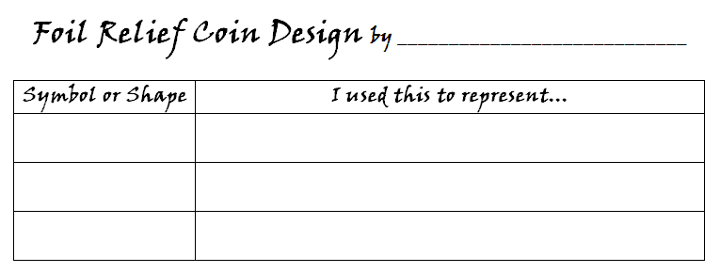
Clean-Up
Coins to display area with LABEL
Wash hands

