Slide 2
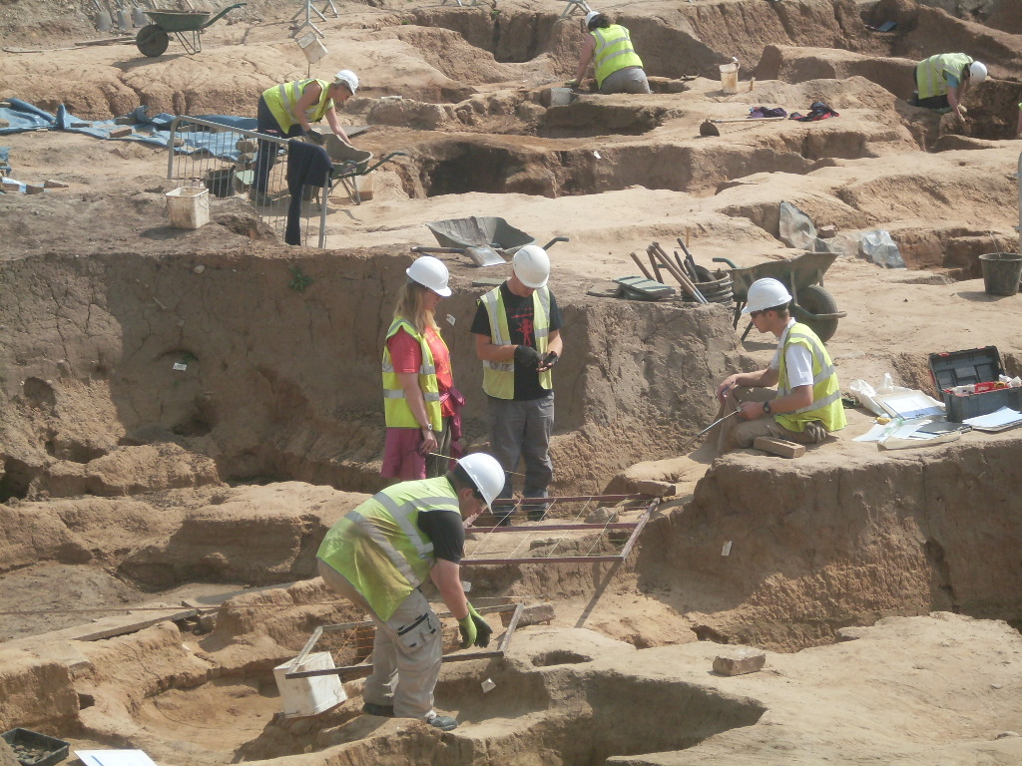
Archaeological Dig

Slide 3
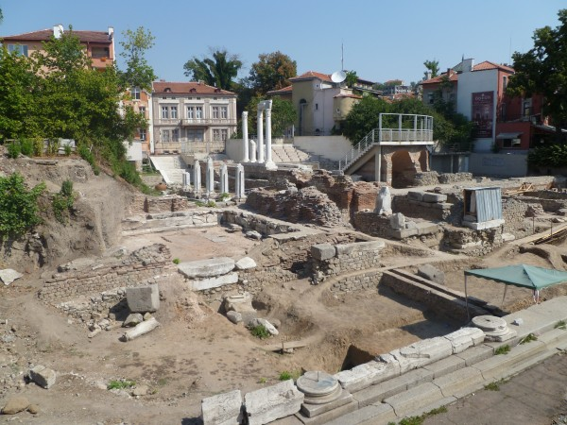
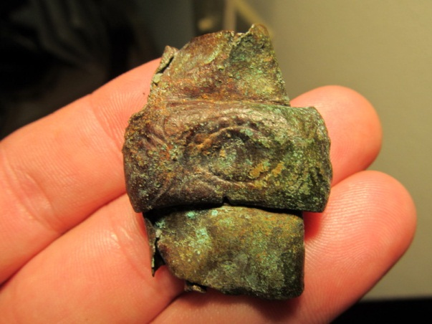
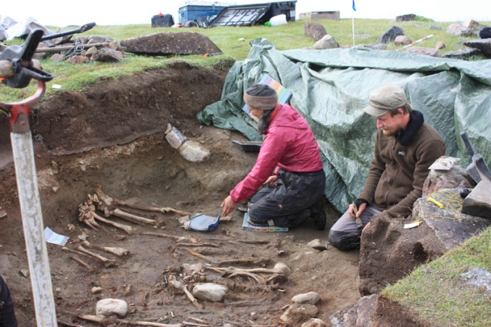
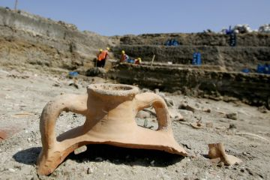
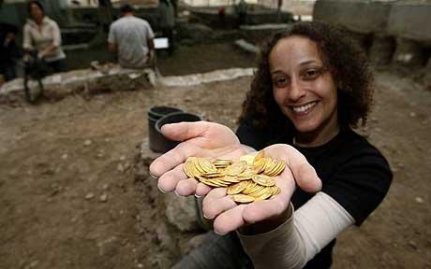
Finds…

Slide 4
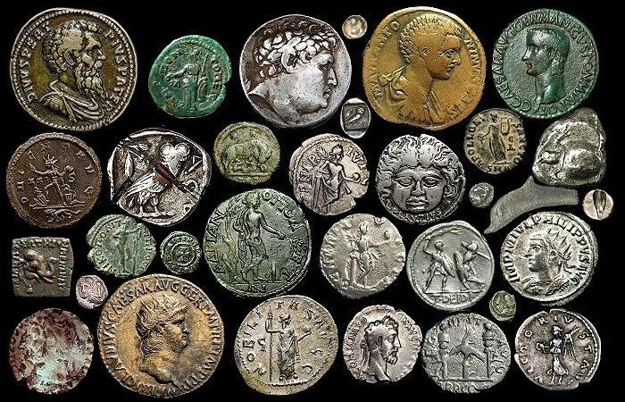
Ancient Coins
Foil Relief Coin Design

Slide 5
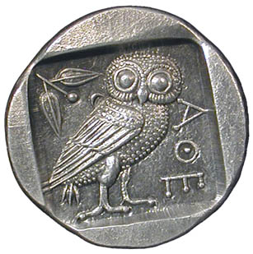
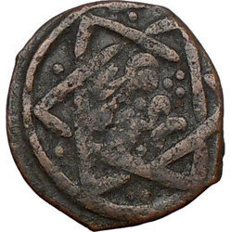
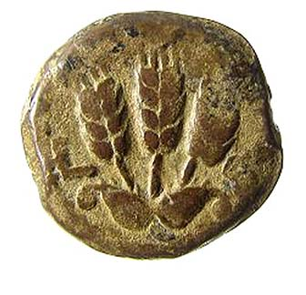
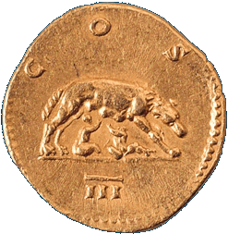
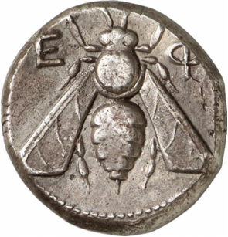
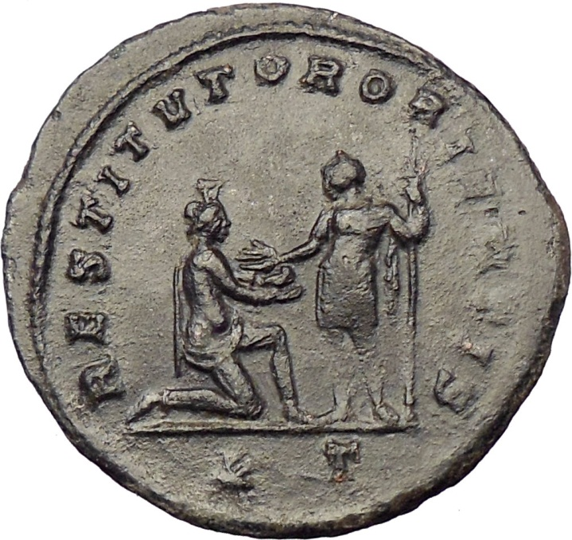
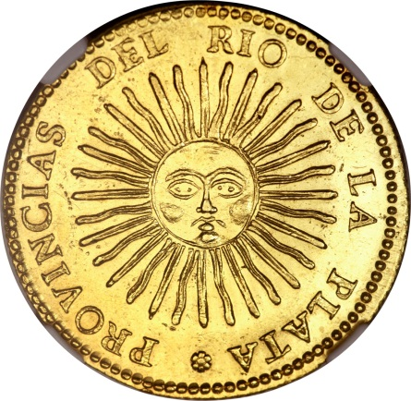

Slide 6
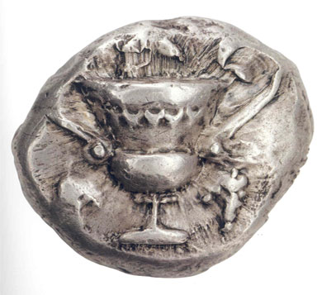
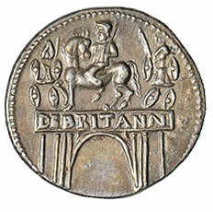
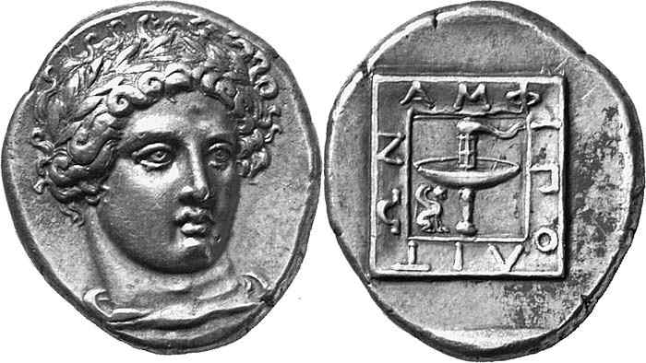
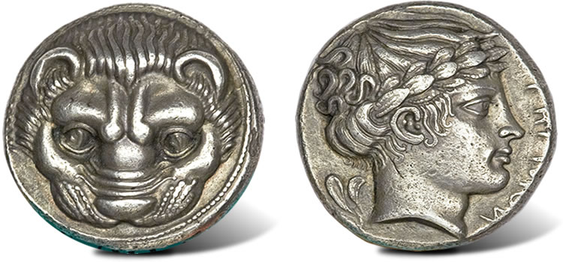
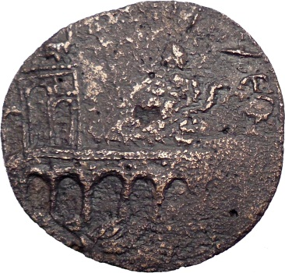
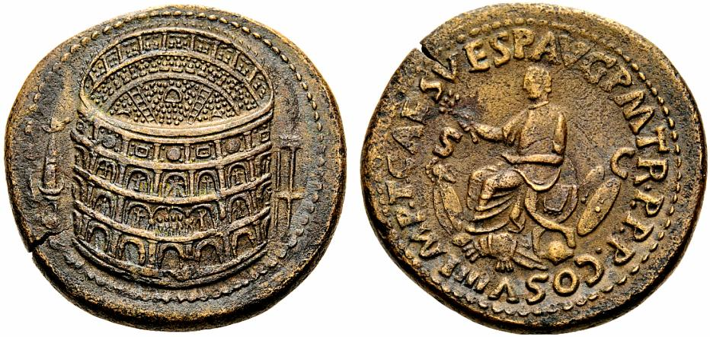
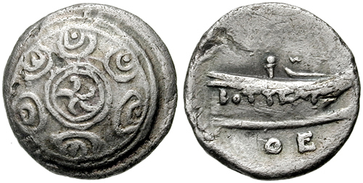
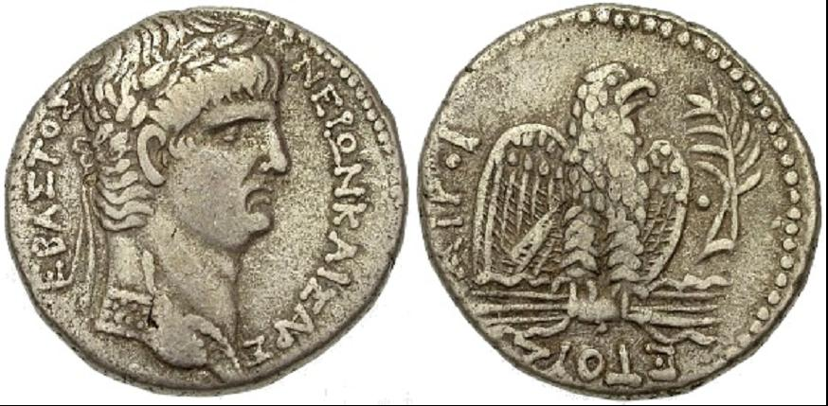

Slide 7
Foil Relief Coin

Slide 8
Start with Ideas…
Think of a topic or theme (e.g., figure, defense, travel, nature, way of life, design/patterns…)
Cut out cardboard circle (name on back!)
Use LINES and BASIC SHAPES
Use the SPACE well
TIP… Leave ‘space’ in design

Slide 9
Process
Decide on a plan for your design
Draw your design onto cardboard
Decide if you would like it to be HIGH or LOW relief
HIGH = will use cardboard pieces glued on
LOW = will use white glue to outline
Create your design in relief using glue OR glued cardboard

Slide 10
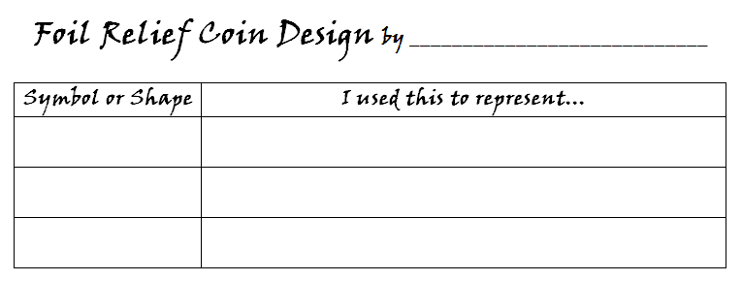
Clean-Up
Coins to drying space (no touch!)
Close and wipe glue lids
Art Label… description of the symbols and shapes you have used, explaining what they represent

