Slide 1
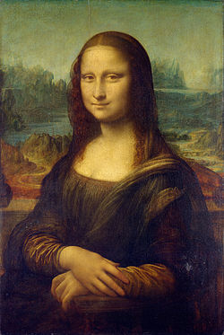

Slide 2
Foil Relief Sculpture

Slide 3
Symbol
A symbol is something such as an object, picture, written word, sound, or particular mark that represents something else by association, resemblance, or convention. For example, a red octagon may stand for "STOP". -definition from Wikipedia

Slide 4
Modern Day Symbols

Slide 6
Characteristics of Symbols & Logos
Represent or ‘stand for’ something
Use of colour & shape
Usually large, simple shapes (limited detail)
Clear; quick and easy to understand

Slide 7
Symbols… Team Logos

Slide 8
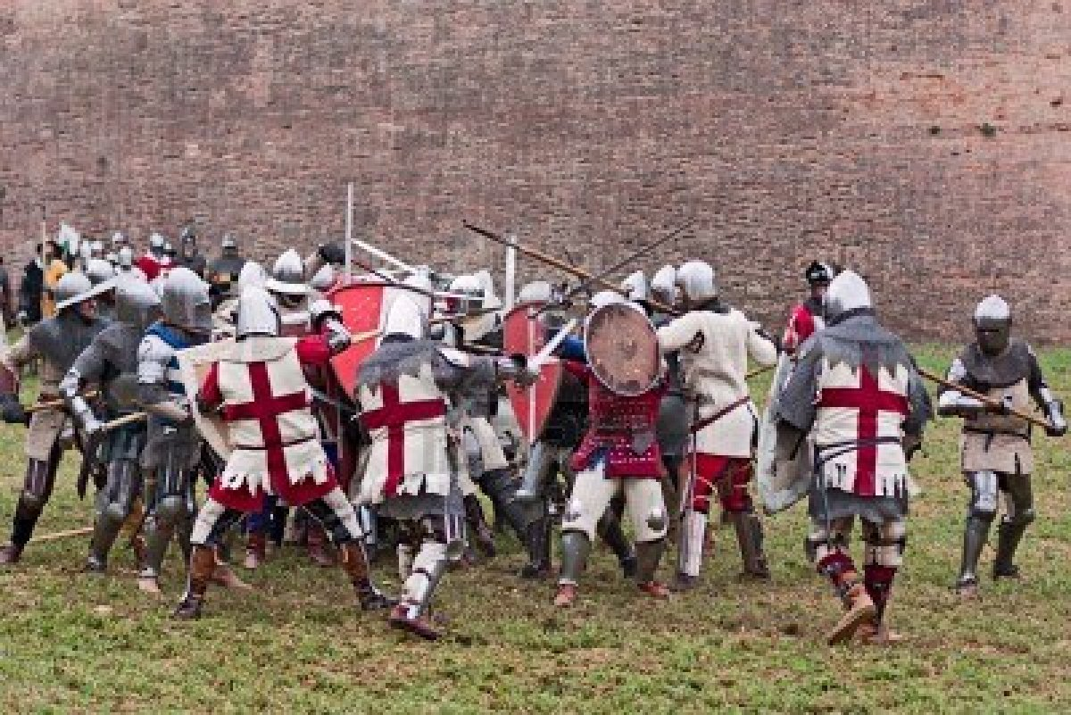
Medieval Battlefield

Slide 9
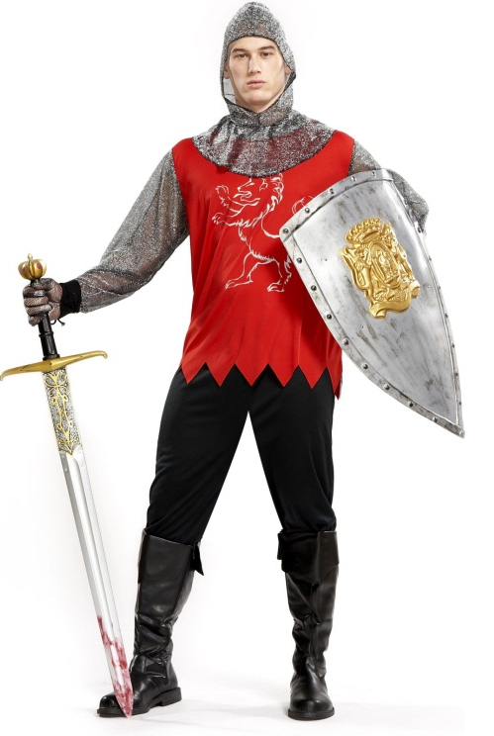
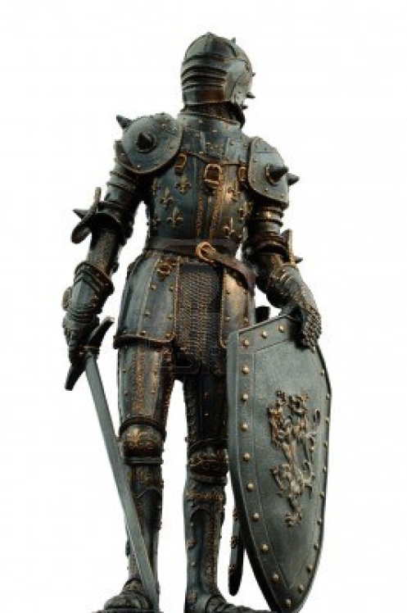
Middle Ages
Heraldry
Knights
Shields
Symbols were used to decorate shields with a knight's coat of arms (heraldic design)
Symbols were also used to decorate the clothing, or surcoat, worn over the knight's armor for recognition purposes
Quick recognition of knights was necessary on the battlefield, so shapes, colors, designs and symbols on their shields and surcoats were important for identification.

Slide 10
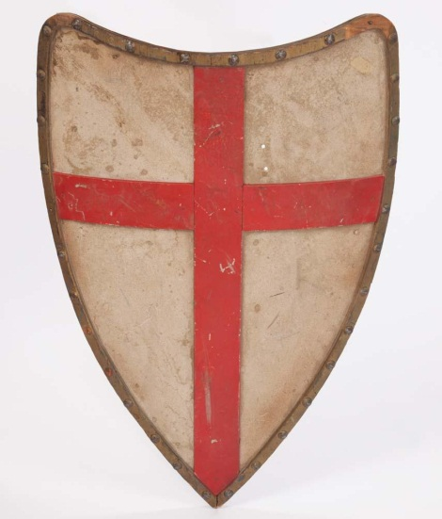
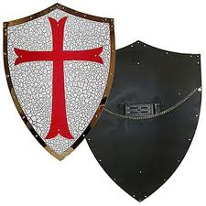
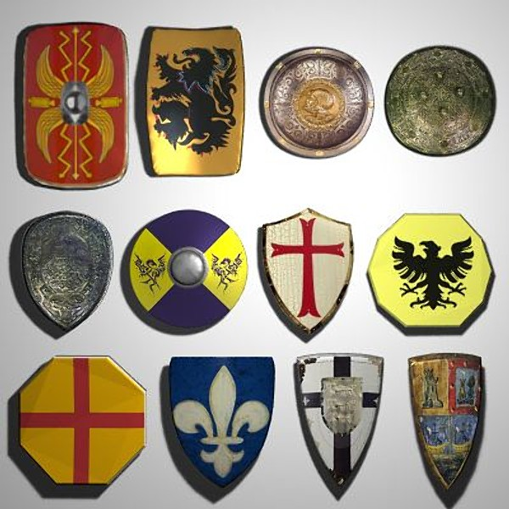
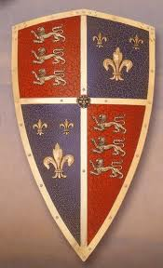
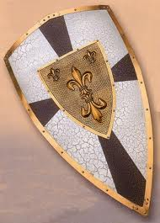
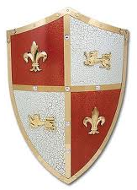
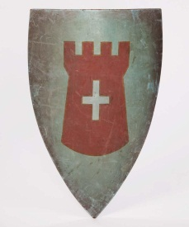
Medieval Heraldry & Shields Use of symbols, shapes and colours
Images

Slide 11
OR… Use modern symbols that tell about you
Hobbies, interests, favourites…
Animals, places, arts, sports, subjects, activities…
Think of clear, simple shapes that will represent your ideas.

Slide 12
Start with Ideas…
Think of a topic, themes or symbols that tell about you OR that were popular in Medieval Times
Sketch your ideas/plan using LINES and BASIC SHAPES
Use the SPACE well; your design should be clear and easy to interpret
TIPS…
Avoid small details (needs to be clear for quick understanding)
Leave some empty ‘space’ in your design

Slide 13
Cutting & Pasting

Slide 14
Relief Sculpture: Foil…
Squeeze or drizzle white glue around the surface of your shield
Gently spread the glue with your finger to cover the entire surface
Quickly wipe your fingers
Lay a sheet of aluminum foil on top of the glued surface (SHINY or MATTE side up – you choose!)
STARTING NEAR THE MIDDLE ON A RAISED PART, GENTLY rub the foil to press and attach it securely around your relief design (With care… avoid rips)
Extra foil gets ‘wrapped’ around to the back of the shield

Slide 15
Inking Process…
At the Inking Station…
Lightly dip your brush in the ink
Apply a light, even layer (WASH) of ink over the surface of your shield
Take your shield back to your work space to dry for just a few moments

Slide 16
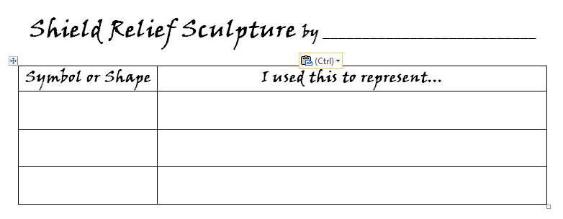
Polishing…
At your work space…
With a square of felt, use a LIGHT, CIRCULAR motion to polish your shield relief sculpture
The foil should start to show through as the ink is lifted from the raised parts of the design
Sign your name on the back with Sharpie
Please return felt and Sharpies to bins
Complete an ART LABEL for your shield.

Slide 17
Clean-Up
Shields to display area with LABEL
All supplies returned/away
Wash hands
Free drawing/sketching time

