Slide 1
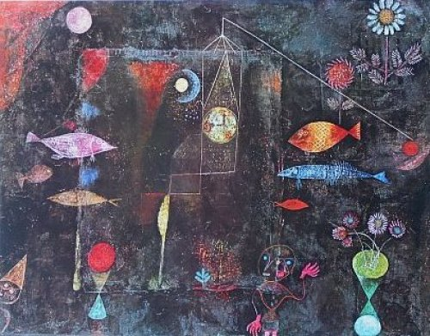
“Fish Magic” by Paul Klee Oil & watercolour varnished; 1925

Slide 2
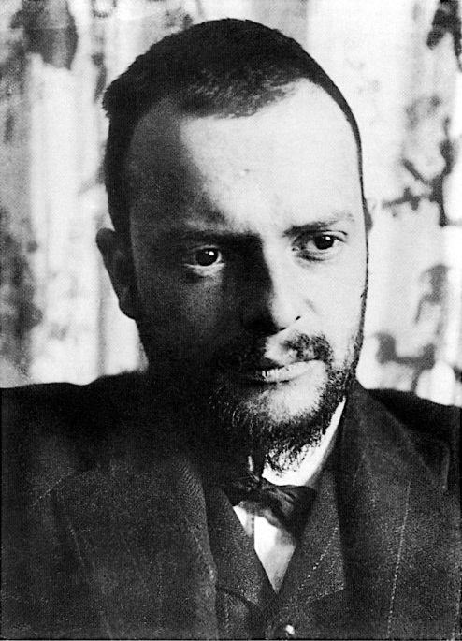
Paul Klee
Born in Switzerland (1879-1940)
Paintings are difficult to classify (associated with Cubism, Expressionism, Surrealism & Abstraction)
Works were often small in size
Used geometric shapes, letters, numbers and arrows, and combined them with figures of animals and people
Included references to poetry, music and dreams; sometimes included words or musical notation
Worked in isolation from his peers, interpreting new art trends in his own way
Used a variety of media (oil, tempera, watercolour, ink, pastel, canvas, linen, burlap, cardboard…)
Taught at Bauhaus school of art, design & architecture; was an effective teacher of colour theory & colour mixing
Suffering from scleroderma, but encouraged by a visit from Picasso & Kandinsky, he created 1200 works in 1939
Iinfo retrieved May 2012 from http://en.wikipedia.org/wiki/Paul_Klee

Slide 3
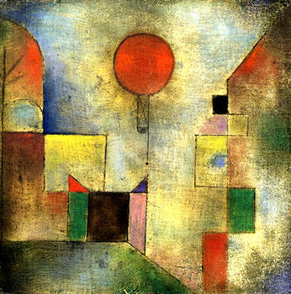
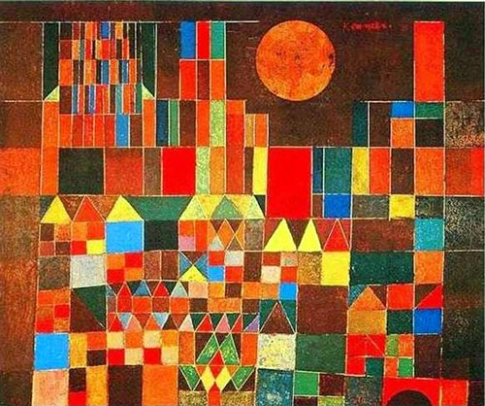
Works by Paul Klee
Fortress and Sun; date unknown
Red Balloon; Oil on muslin; 1922

Slide 4
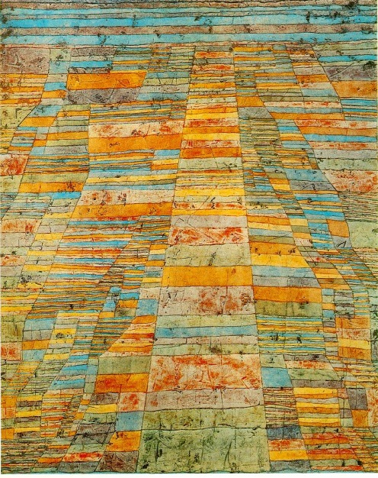
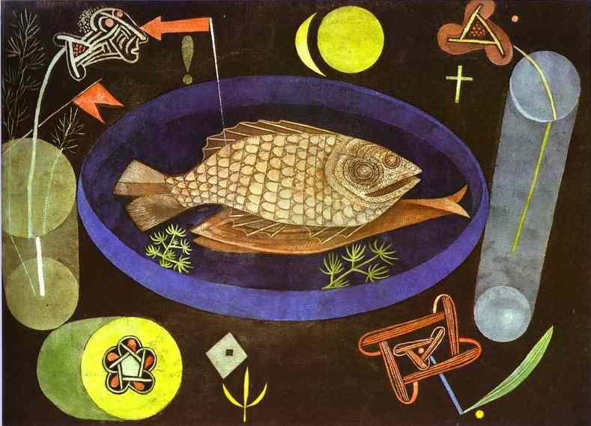
Works by Paul Klee
Around the Fish; Oil & Tempera; 1926
Highways & Byways; Oil on canvas; 1929

Slide 5
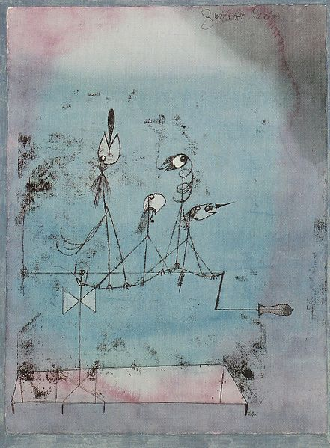
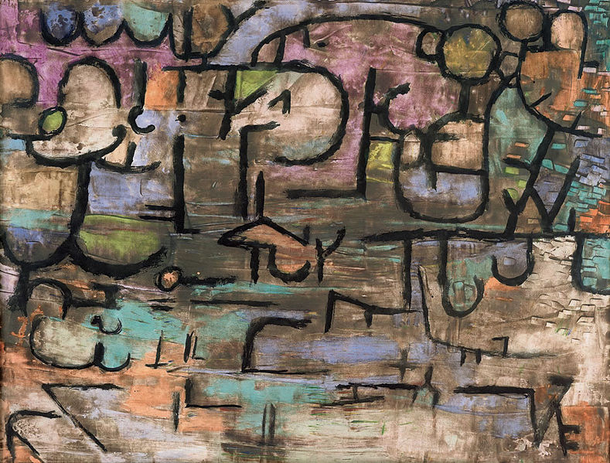
Works by Paul Klee
After the Flood; 1936
Twittering Machine; Mixed Media; 1922

Slide 6
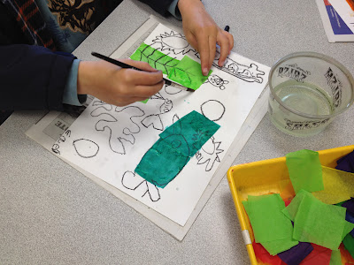
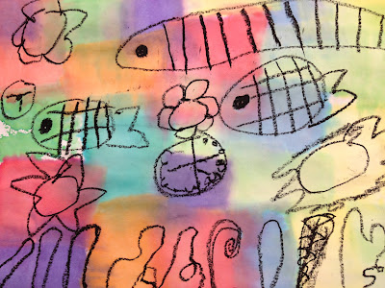
Underwater Fantasy Inspired by Paul Klee
Images retrieved May 2012 from http://teachkidsart.blogspot.ca/

Slide 7
Underwater Fantasy Inspired by Paul Klee
Using a black crayon or oil pastel, draw an underwater scene on your paper .
Add some things that you wouldn't normally find underwater.... a clock, flowers, people, etc.
Lay some squares of "bleeding" art tissue on your paper; use paint brush to apply water on top of the tissue.
Repeat #3, covering as much or as little of your paper with color as you like. Use plenty of water so your tissue will "bleed"!
5. Set aside to dry.
Image & Lesson retrieved May 2012
from http://teachkidsart.blogspot.ca/

Slide 8
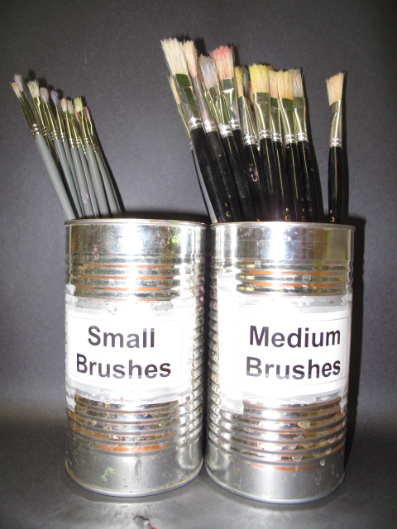
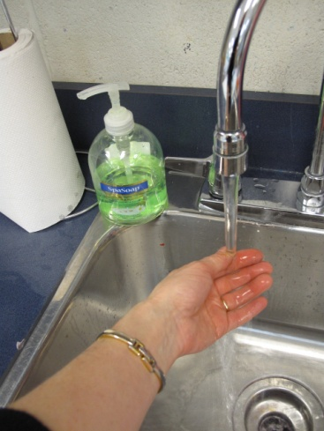
Artist’s Clean-Up
Artworks to drying space
Wipe/dry hands & return all leftover tissue paper
Recycle newspaper
Wash brush and store properly (bristles up!)
Wash hands
Sketchbooks

