Slide 1
Colour Theory, Looking at Art & Printmaking

Slide 2
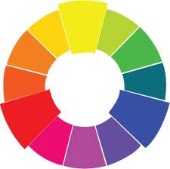
Colour Wheel
warm
cool

Slide 3
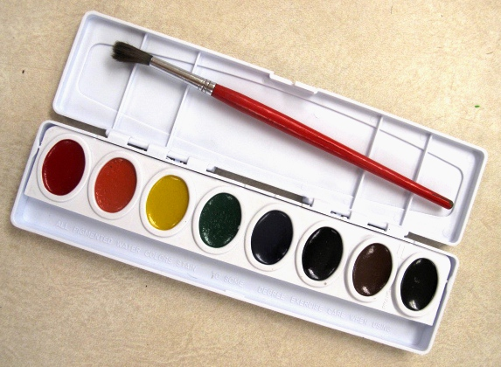
Watercolour

Slide 4
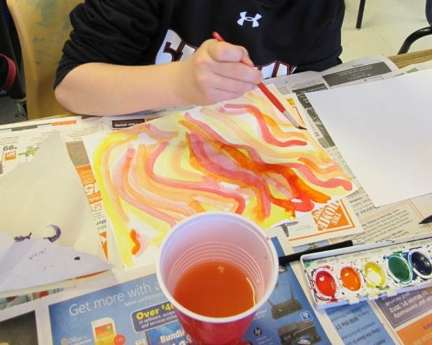
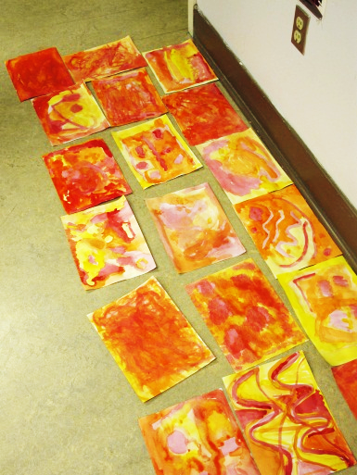
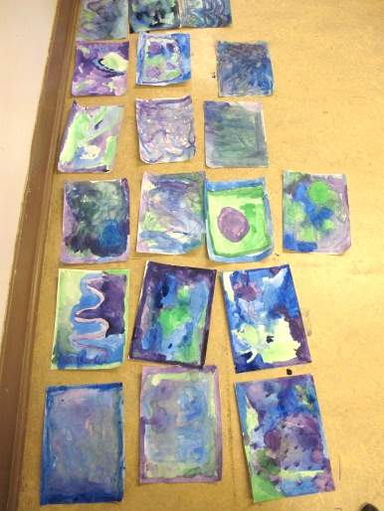
Painting the Backgrounds
Warm colours
Cool colours

Slide 5
Colour Wheel
warm
cool

Slide 6
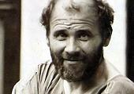
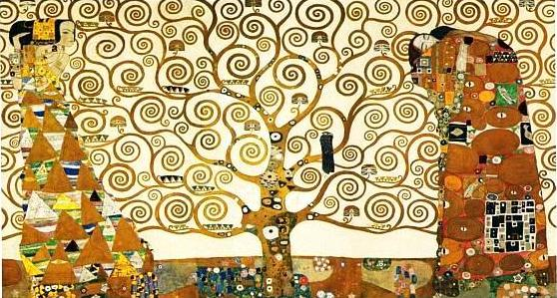
The Tree of Life By Gustav Klimt; 1909 (1862-1918)

Slide 7
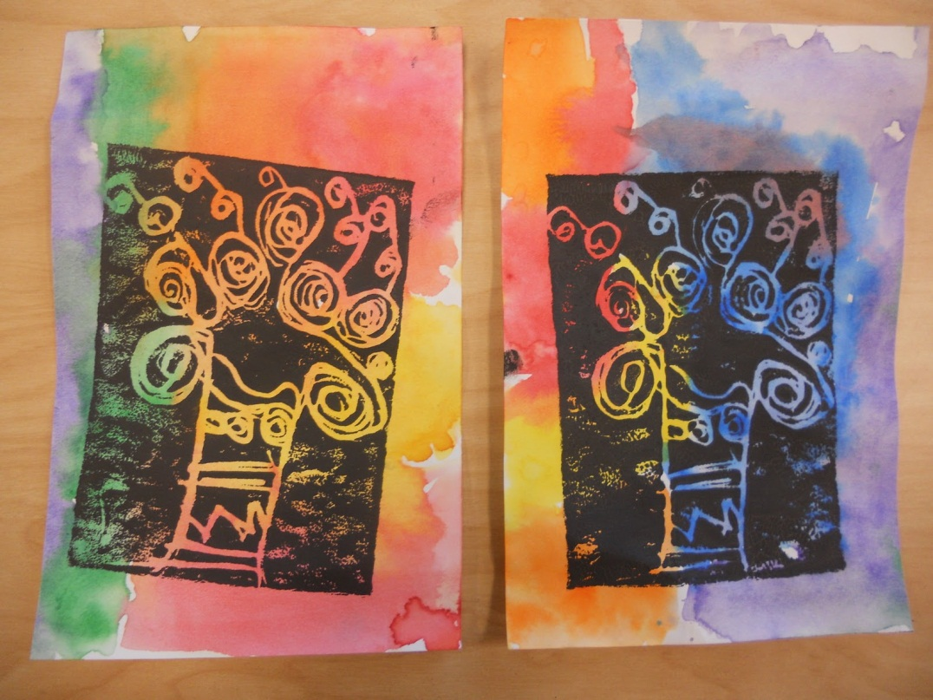
“Tree of Life” & Printmaking
From Panther’s Palette Blog…
http://pantherspalette.blogspot.ca/2010_12_01_archive.html

Slide 8
Printmaking Creating a Printing Plate
START… Sketch/Plan your ideas
experiment with lines and shapes to create stylized trees;
consider use of space
choose your favourite *
Designs will appear IN REVERSE when printed!
(mirror-view)

Slide 9
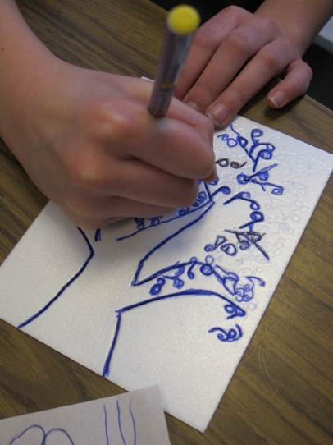
Printmaking Creating a Printing Plate
THEN,
Lightly ‘trace’ tree design on to foam printing plate with a ballpoint pen
Gently ‘carve’ your design into the foam plate, re-tracing your lines
Press GENTLY BUT FIRMLY (indent, but not all the way through!)

Slide 10
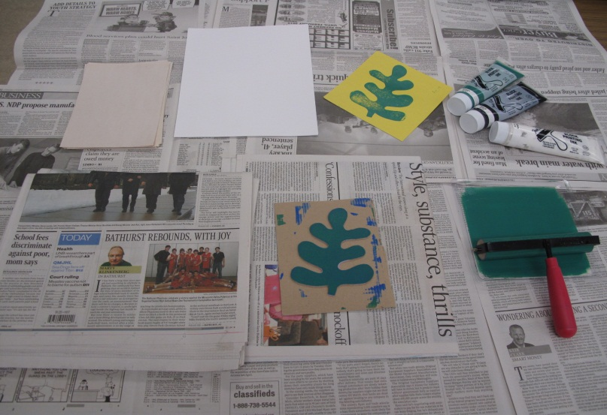
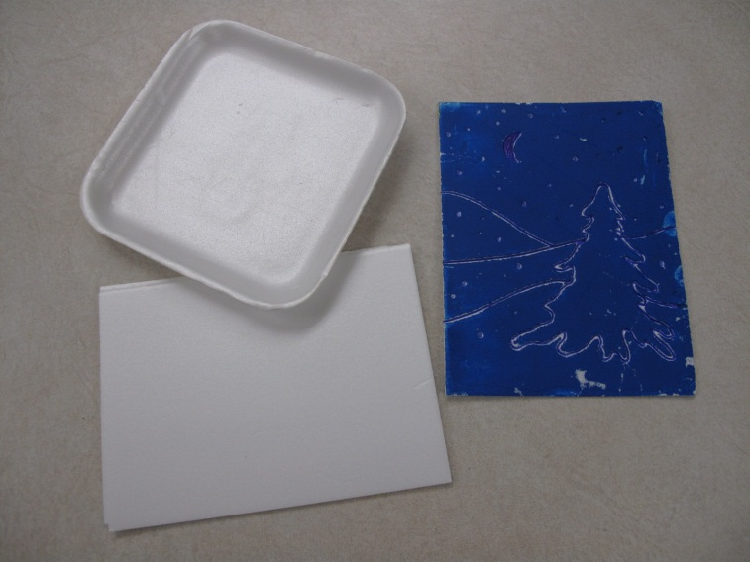
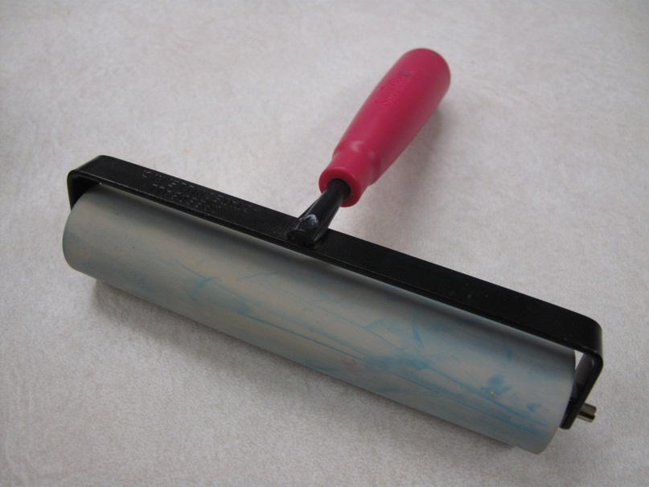
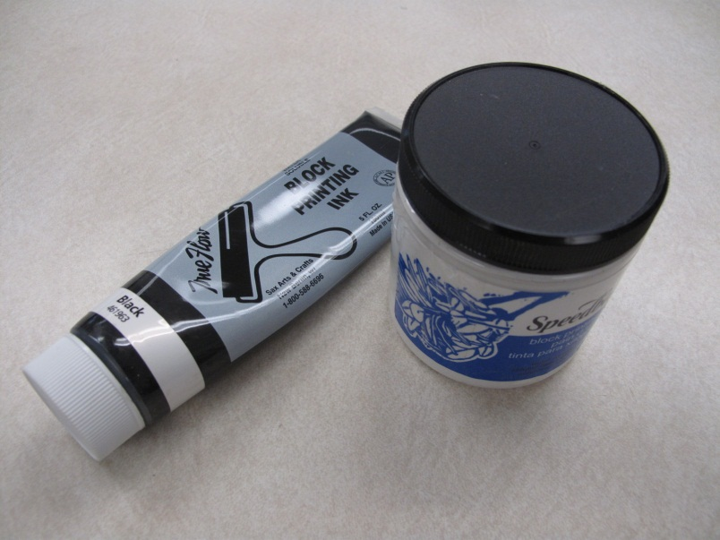
Printing plate
Printing Station…
brayer
Water-soluble printing ink

Slide 11
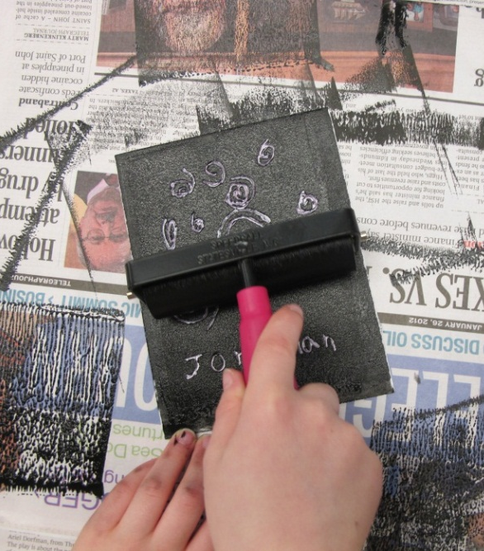
Gr. 3 Printmaking…

Slide 12
Artist’s Clean-Up
Wash printing plate
Wash hands
Sketchbook Time

