Slide 1
Public Sculpture in New Brunswick
PowerPoint Created by: Sara Branch

Slide 2
What is Sculpture?
"Sculpture is the only branch of the visual arts that is specifically concerned with expressive three-dimension form.“
Encyclopedia of Art. http://www.visual-arts-cork.com/sitemap-world-art.htm

Slide 3
What is Public Art?
Art that is designed to be situated in a public space.
Art that is accessible to all.
Public art can be outside or in public building.
Art designed to engage community.

Slide 4
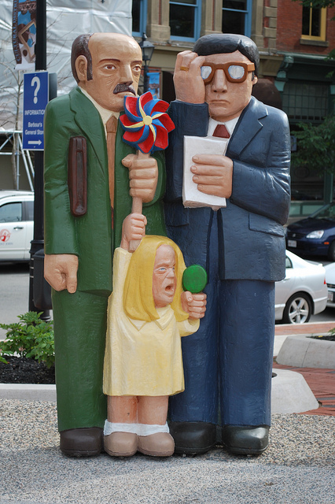
Most Popular Sculpting Materials
Hard Limestone (marble)
Wood
Clay
Metal (bronze)
Ivory
Plaster
These materials are the most popular because of their excellent “plastic” qualities.
Four key techniques: Stone Carving, Wood Carving, Bronze Casting and Clay Firing

Slide 5
New Brunswick Sculpture
Throughout New Brunswick there are hundreds of public sculptures. This slide show shares only some of the many sculptures that are part of our cities, villages, and towns in this province. I hope learning a little about these public sculptures will encourage you to go visit these works of art that help define our communities, culture and commemorate our historical events. It is also hoped that you begin to notice and appreciate the public art in your own community.

Slide 6
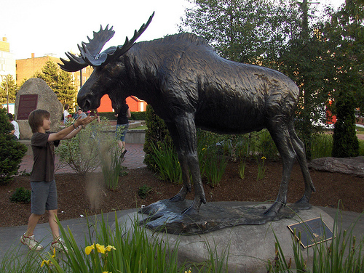
Saint John, New Brunswick
Public Art

Slide 7
Moosehead Moose: Created by: Forest Hart
Bronze Statue of moose located in Saint John, N.B. Created for Moosehead Breweries. The Moose is a natural symbol for New Brunswick as there are many of these animals throughout the province.

Slide 8
“In Transit” created by: Monica Adair and Stephen Kopp
Situated in East Saint John, this public art is constructed from 85 unique aluminum panels. Each panel portrays a traffic sign. The panels are attached to a retaining wall, creating a colorful scene along McDonald Street. This piece of public art was created because of the 1% for Art Program is part of the Saint John Arts and Culture Policy. This policy was adopted by council on September 20th , 2005. The goal of this program is to develop culture and the arts in Saint John, to generate opportunity for artists to create works for public spaces and to increase awareness of the visual arts in Saint John.

Slide 9
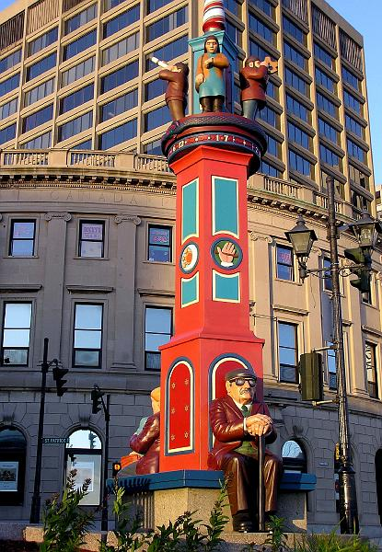
“Time Piece”- Created by: John Hooper and Jack Massey
This piece is located in uptown Saint John. This piece is a clock tower. The carvings are all connected to time. There is a clock at the top but with no face. It is for the viewer to figure out how to tell time with this sculpture. This sculpture was created with Honduras Mahogany and the carvings are painted with acrylic paint.

Slide 10
3 meter tall Sculpture of Union Jack
Sculpture commemorates Saint John’s relationship with the Loyalists. Their arrival in 1783 led to the creation of our province and the city of Saint John.

Slide 11
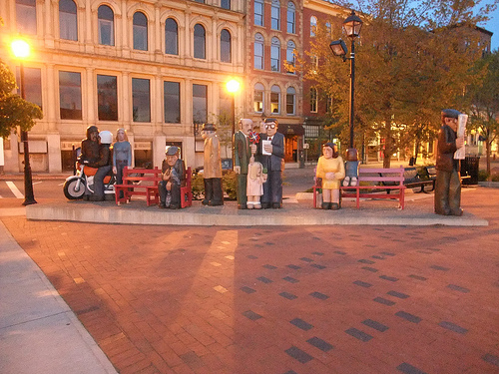
“People Waiting” By: John Hooper
Located outside of the Barbour’s general store on King Street. The sculpture was originally outside the Rothesay Avenue Canada Post Office for 30 years. These sculptures were in storage for several years as they needed repairs. Thankfully this public art is back in an outdoor area where all people can visit and enjoy.
“ John Hooper was known for his works of public art in public places. These works were originally commissioned by the federal government to be outdoors. The public should enjoy them in an outdoor setting. They are very interactive. It’s the kind of work people will enjoy and I encourage people to look closely at the works in all directions at all sides because there’s a lot of secret things going on you can’t notice if you look at them and just walk by them”. -Bernard Cormier (Cultural Affairs Officer for Saint John)

Slide 12
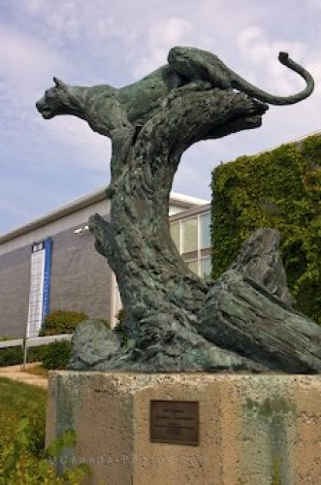
Fredericton, New Brunswick
Public Art

Slide 13
“The Leopard” Created in 1985 by: Jonathan Kenworthy
Located at entrance of Lord Beaverbrook Art Gallery. The leopard is sculpted in a position to prey. The artist was inspired by survival tactics of animal and people.

Slide 14
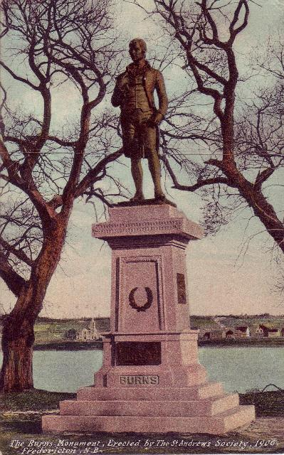
The Statue of Robert Burns
This 100 year old sculpture was taken down for repairs in 2008. The future of this statue was unknown since it needed 80,000 dollars in work to make the statue flood proof. The community campaigned to have this statue of the poet restored. J.K. Irving and Jean Irving donated the money to have sculpture restored. Robert Burns day is celebrated on January 25th.

Slide 15
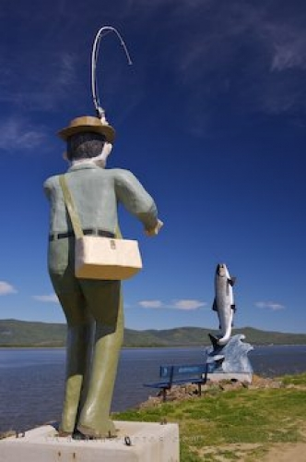
Campbelton, New Brunswick
Public Art

Slide 16
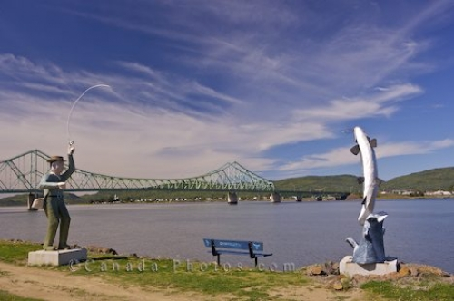
Fisherman with a Hooked Atlantic Salmon
This statue is situated along the Restigouche River. An area known for large Atlantic salmon. Angling and fly-fishing are very important to the region.

Slide 17
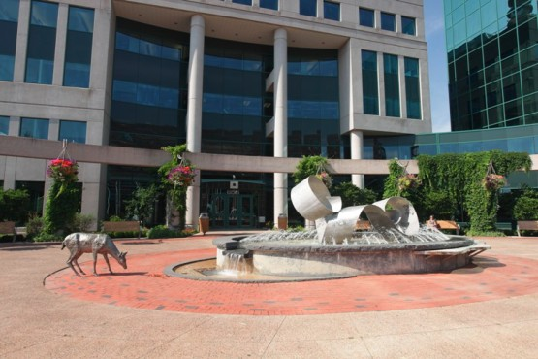
Moncton, New Brunswick
Public Art

Slide 18
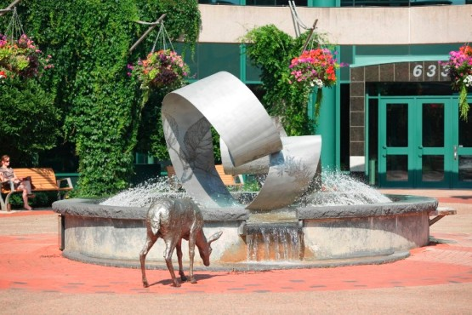
“Waveflow” By: Kip Jones & Jennifer Macklem
Located in front of Moncton City Hall. Made of cast bronze, stainless steel and granite. The pool holds water and jets spray upwards around the statue. There is a waterfall at one end and a life size bronze deer drinks near the basin.
“ Our project is inspired by the idea of a wave: a wave of water and wind… it is inspired by the natural forms and energy and serves as a reminder of our surrounding environment within an urban context.” – Macklem and Jones on describing Waveflow

Slide 19
Sources:
Encyclopedia of Art: http://www.visual-arts-cork.com/sitemap-world-art.htm
Wikimedia Foundation, Inc.: http://www.wikimediafoundation.org/
Market Square: http://www.marketsquaresj.com/artwork.php
CBC: http://www.cbc.ca/news/canada/new-brunswick/story/2009/09/04/nb-john-hooper-art-1258.html
CBC: http://www.cbc.ca/news/canada/new-brunswick/story/2011/09/10/nb-robert-burns-statue-unveiled.html
Google Images
http://www.uelac.org/Loyalist-Monuments/Flag-Sculpture.php
http://publicartprojectunbfredericton.wordpress.com/public-art-in-nb/
http://www.moncton.ca/Residents/Recreation_Parks_and_Culture/Arts_and_Culture/Public_Art_in_Moncton/Waveflow.htm?PageMode=Print
http://spacingtoronto.ca/2008/07/10/saint-john-new-brunswick-solid-urbanism/
About Sara Branch:
Sara Branch is an elementary school teacher and a Masters in Education student. She created these slides as part of an independent study in Visual Literacy and Sculpture.

