Slide 1
The New Brunswick International Sculpture Symposium
PowerPoint Created by: Sara Branch

Slide 2
International Sculpture Symposium
The symposium will take place from August 2nd, 2012 to September 15th, 2012.
Six skilled artists were chosen from around the world to travel to Saint John to sculpt New Brunswick granite into works of art!
The public is encouraged to visit the sculpting site at the Coast Guard station on the Saint John waterfront to watch the sculptors as they create permanent works of art for the Saint John and surrounding areas.

Slide 3
The History: 1959- present
First sculpture symposium in modern times was held in Austria in 1959.
Since this time Sculptors have come together to create in places around the world.
The Sculptors learn from other participating artists and from the symposium setting.
This year (2012) the symposium is in Saint John, New Brunswick.

Slide 4
The History: 1959- Present
This is a time for sculptors to learn new techniques and concepts as well as a time to learn about a new culture.
The symposium encourages the public to get involved and to learn about sculptures and how to create public art.
By the end of the symposium, the sculptures that were created will become part a permanent part of the community’s landscape.

Slide 5
Sculpting Material: Hamstead Quarry
The sculptors will use local rock from the Hamstead Quarry.
This New Brunswick quarry started producing granite in 1840.
The stone is a fine grey granite and/or a pink granite
This stone has been used to build bridges, buildings, and monuments in New Brunswick and beyond.

Slide 6
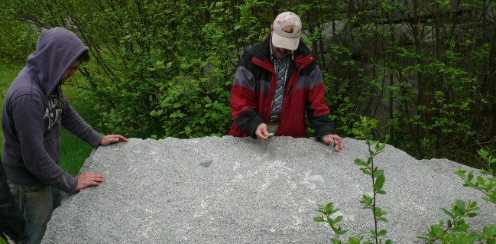
Sculpting Materials: Hamstead Quarry
This stone was used in these Saint John structures: The Old Public Library, St. John the Baptist Church, Champlain monument, Old Penitentiary, Queens Square Centenary Church.
Last worked in 1990’s.

Slide 7
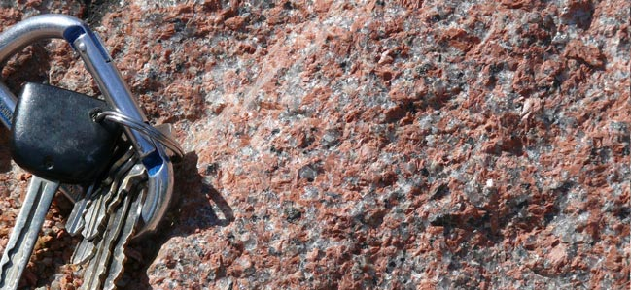
Sculpting Materials: St. George Quarry
Sculptors will use stone from St. George Quarry
Between 1872 and 1940 there were over 50 quarries operating in the St. George area.
The red granite from these quarries ranges from light pink to deep red.
Competition from European sources, large U.S Tarrifs in the early 1900s and the great depression deeply impacted the operations of these quarries.
Operation ceased in the 1940’s.

Slide 8
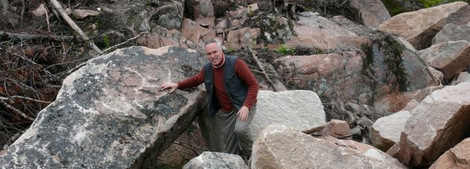
Sculpting Materials: St. George Quarry
The stone being used in the sculpture symposium is from old grout piles that were created over a century ago,

Slide 9
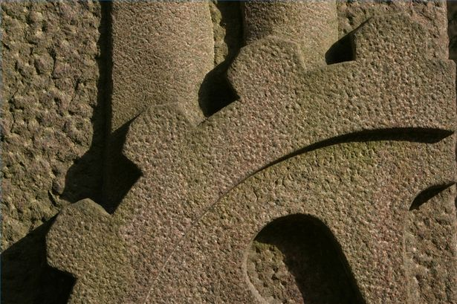
Fun Facts about Granite
Granite is one of the toughest kinds of igneous rocks.
Granite is often called “monumental stone” because it is the most common rock used for sculpting monuments.
The most widespread color of granite is gray.
Granite can also be found in shades of pink, green and yellow.
Granite is a very difficult stone to carve.

Slide 10
Carving Granite:
Items you need to wear:
Gloves
Hard Hat
Goggles
Dust Mask
Heavy Boots
Wrist Guards
Ear Plugs
Tools used:
Carbide tipped chisels
Sandpaper
Pencil or Crayon
Grinder saw (Diamond or Masonry Blade)
Steel Stone Hammer
Pneumatic chisel
Claws, Rasps and Files

Slide 11
Carving Granite: Step by Step
Step 1: Wear the proper protective gear! Wear both goggles and your dust mark. Artists must be careful of flying granite pieces as well as the dust from granite which contains silica and can harm your lungs if inhaled. The area the sculptor works in should also be well ventilated.
Step 2: Wear Ear Plugs! You do not need power tools (pneumatic tools) to carve granite but it greatly speeds up the process. These tools will be used during the symposium. The power tools are very loud and your ears need to be protected or else hearing loss can happen.

Slide 12
Carving Granite: Step by Step
Step 3: Wear high quality work gloves, hard hat and heavy boots. Granite can be very sharp like glass. Wearing the proper gear protects the sculptor from injury. Wrist guards should also be worn to help stop the development of carpal tunnel syndrome.
Wearing the proper clothing and equipment is very important when carving stone.

Slide 13
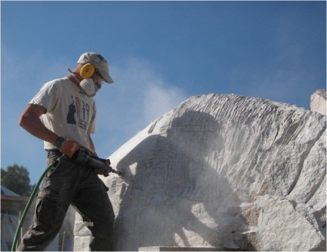
Carving Granite: Step by Step
Step 4: Take a pencil or crayon and mark the excess area of the granite that you will want to eliminate.
Step 5: With a grinder saw you can remove large chunks of the granite. The sculptor may saw off entire sections of the granite or make smaller cuts to later hammer out.
Step 6: The sculptor will then use a carbide-tipped chisel and hammer to remove smaller pieces of the rock.

Slide 14
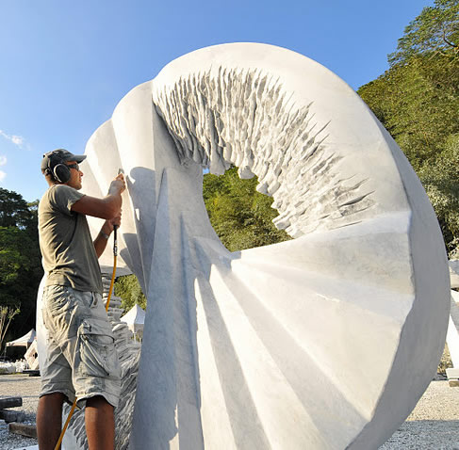
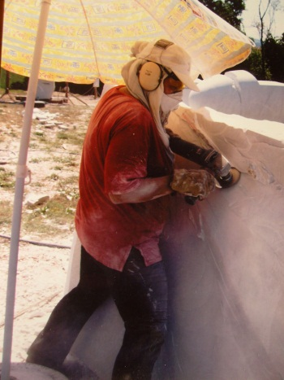
Carving Granite: Step by Step
Step 7: Once areas of the granite are removed the sculptor can shape the stone using claws, rasps and files.
Step 8: The final step is to sand the sculpture. The trick is to start with coarser grades of sand paper and eventually end with the finer sand paper. Each grades eliminate the marks from the previous coarser grade of sand paper.

Slide 15
Meet the Artists:
Jim Boyd- Hampton, New Brunswick
Hiroyuki- Osaka, Japan
Jhon Gogaberishville- Vani, Georgia
Jo Kley- Ulm, Germany
Agnessa Petrova- Bulgaria
Radoslav- Bulgaria

Slide 16
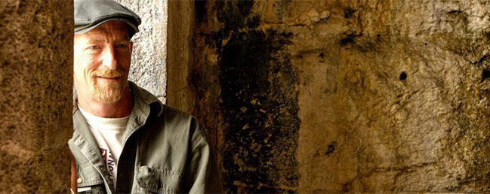
The Artists - Jim Boyd
48 years old
From Hampton, New Brunswick
BFA Major in Sculpture from N.S.C.A.D. in Halifax
BED from University of New Brunswick
Participated in Schoodic (Maine) International Symposium in 2011
“ My studio in Hampton is not set up for such large scale work so I found it very liberating to work big for a change. One of the things I liked about participating in a symposium was that I was focused everyday on stone carving. The menial tasks that one is often distracted by when living at home were swept aside for six weeks.” – Jim Boyd

Slide 17
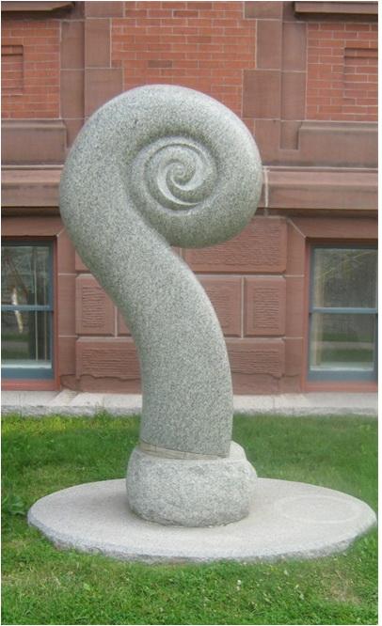
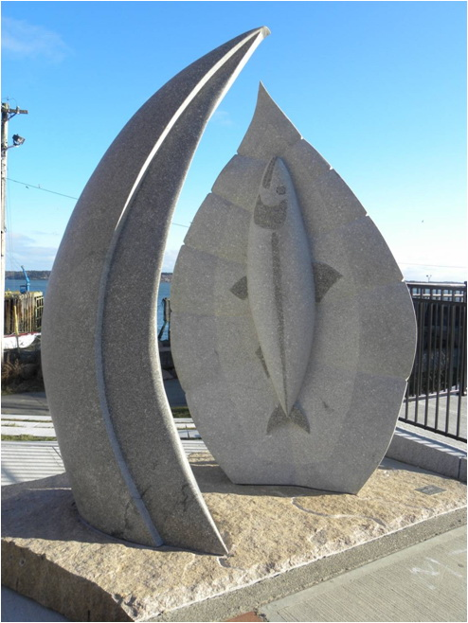
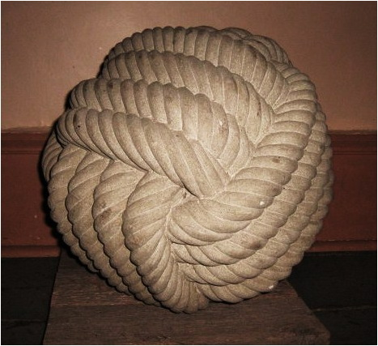
The Artists- Jim Boyd

Slide 18
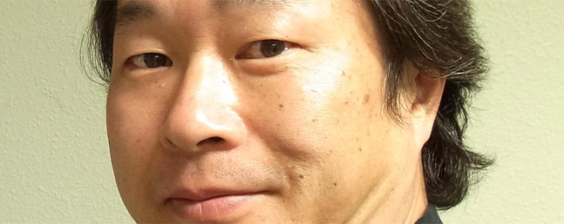
The Artists- Hiroyuki
49 years old
Born in Osaka, Japan
Graduated from Osaka University of the Arts
Sculptor and Professor at Tokyo Gakugei University
Participated in 13 previous symposia
“I am very much interested in Saint John and the East Coast in Canada. Grand land and sea, and the wind of the ground will certainly suit the concept of my sculpture. My sculpture is expressing time. My sculpture will make the scenery of ancient Saint John imagine exceeding space-time far.”- Hiroyuki

Slide 19
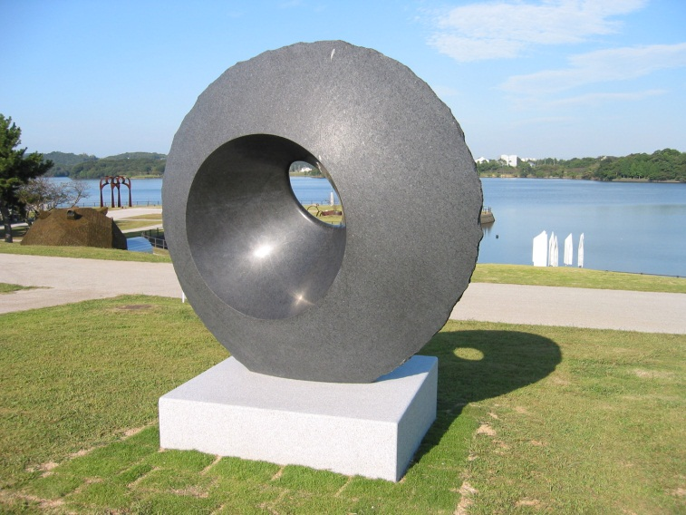
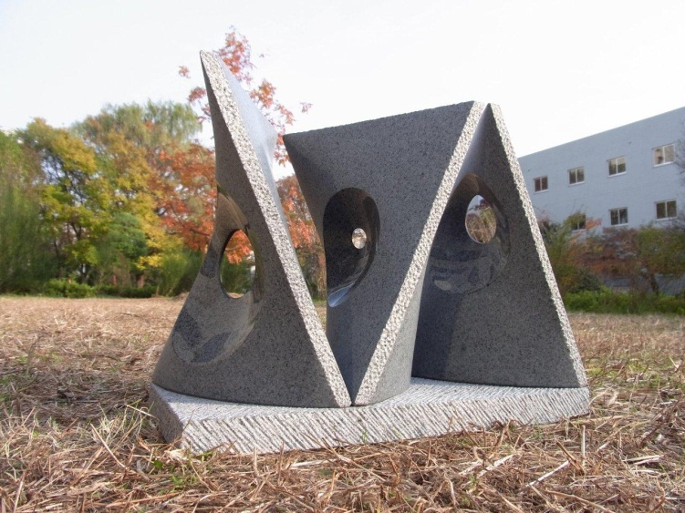
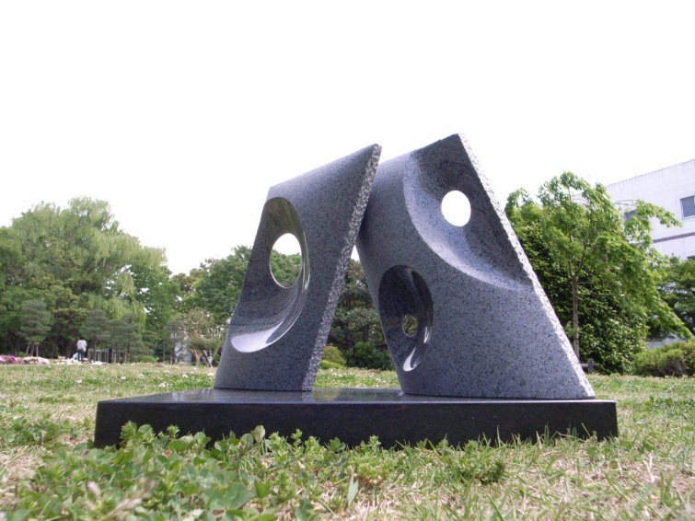
The Artists- Hiroyuki

Slide 20
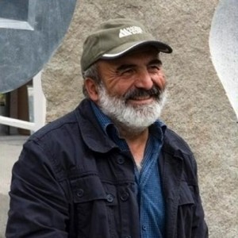
The Artists- Jhon Gogaberishville
58 years old
Born n Vani, Georgia
Attended the Tbilisi State Academy of Fine Arts
Participated in 40 previous symposia
“Symposiums for me is a live creative process, where you get different cultural acquaintance.”
-Jhon Gogaberishville

Slide 21
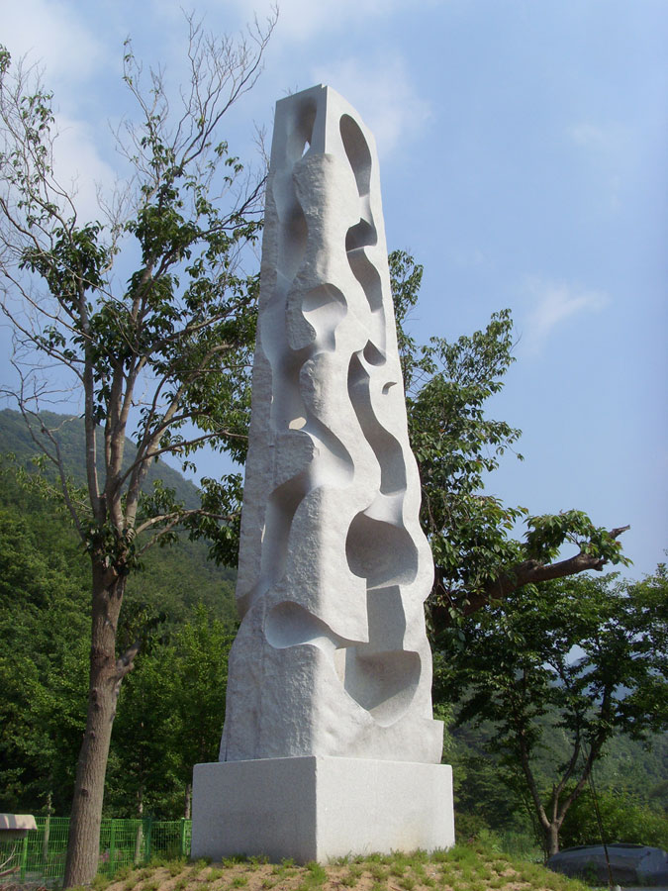
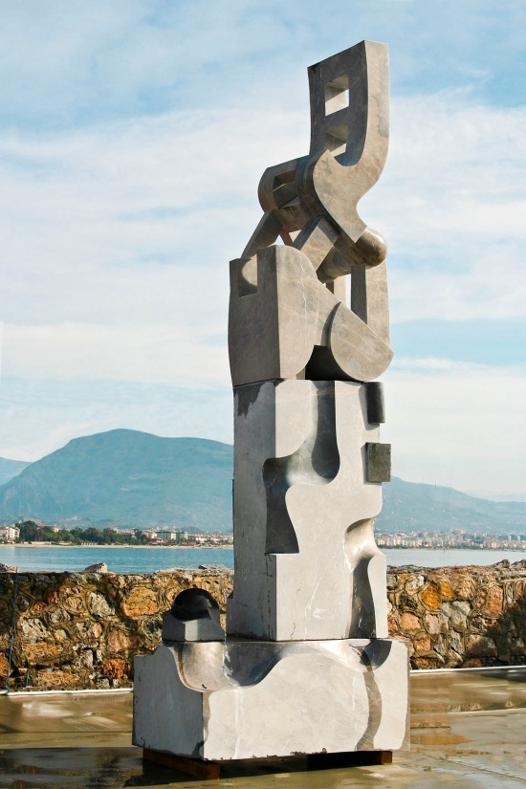
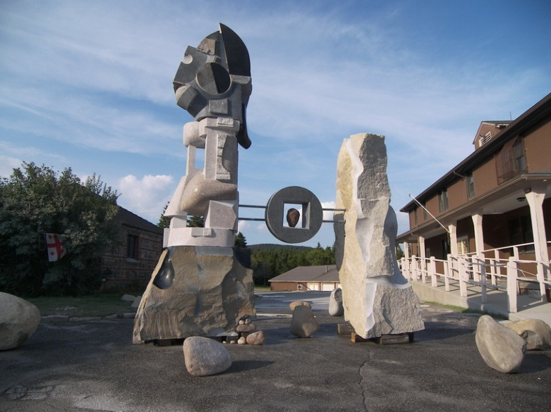
The Artists- Jhon Gogaberishville

Slide 22
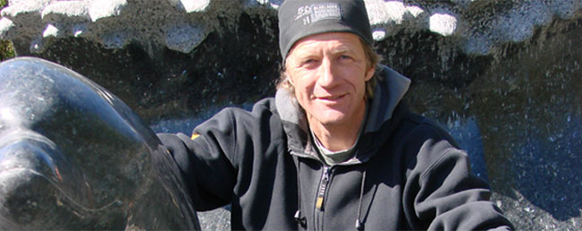
The Artists- Jo Kley
48 years old
Born in Ulm, Germany
Doctor of Liberal Arts student at University of Pecs in Hungary
Participated in 35 previous symposia
“I am fascinated by the classical works of Michelangelo, Bernini or Thorwaldsen, yet also by the early works of Ancient Greece, whose evocative mythological layers often provide the inspirational materials of my (stony) dreams and work of classical deities.” – Jo Kley

Slide 23
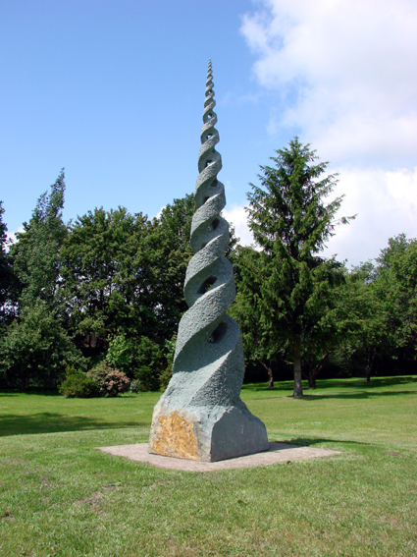
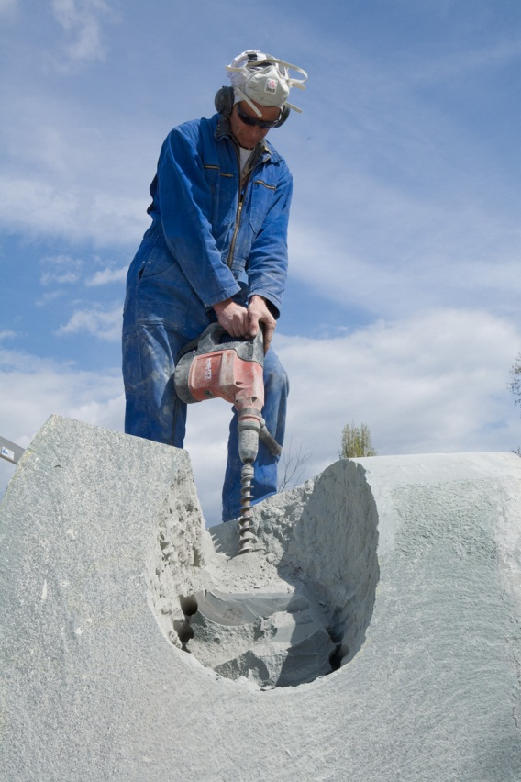
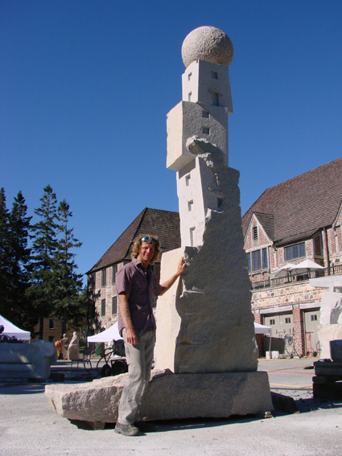
The Artists- Jo Kley

Slide 24
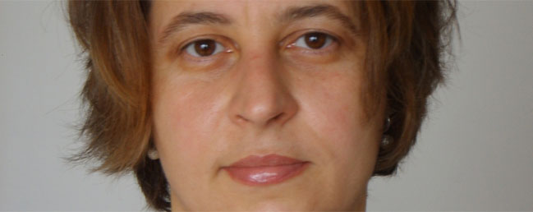
The Artists- Agnessa
44 years old
Born in Bulgaria
PhD in Art History from the Fine Art Academy in Sofia, Bulgaria
Involved in many painting and sculpting projects and exhibitions
Previously participated in 16 sculpture symposia
“I am always excited about the raw power of stone. Also the work with granite often send me back in the time, when this hard, solid and durable material was moving fiery lava, having an enormous energy. All the energy of the hot lave is kept in this raw material, exiting with its frozen Beauty and Power.” – Agnessa Petrova

Slide 25
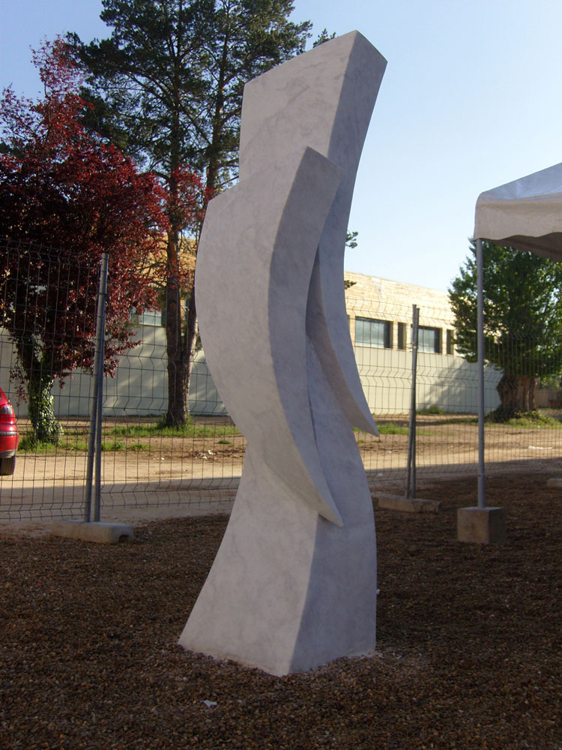
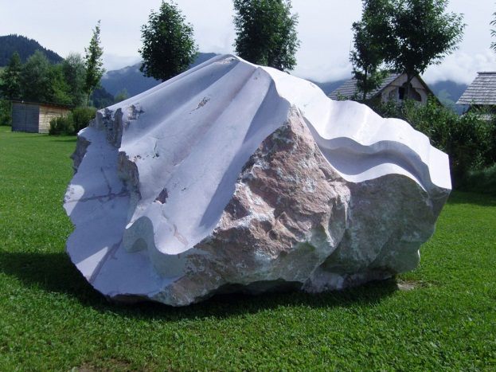
The Artists- Agnessa Petrova

Slide 26
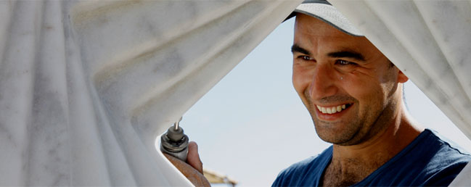
The Artists- Radoslav
35 years old
Born in Bulgaria
Master of Fine Arts in Sculpture from the National Academy of Fine Art in Sofia, Bulgaria
Participated in 8 international symposia
“I’d be delighted to take part in the Saint John sculpture symposium. I find the ambiance of the waterfront symposium work placement as well as the structure and history of the granite rock material very inspiring.” – Radoslav

Slide 27
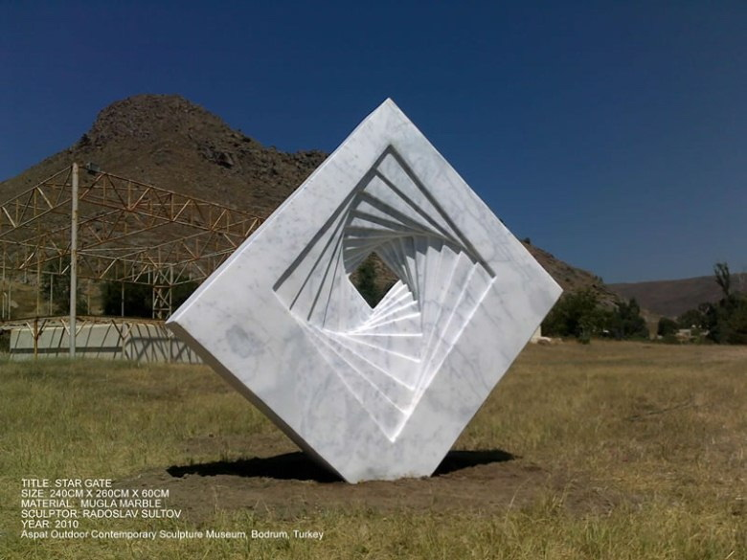
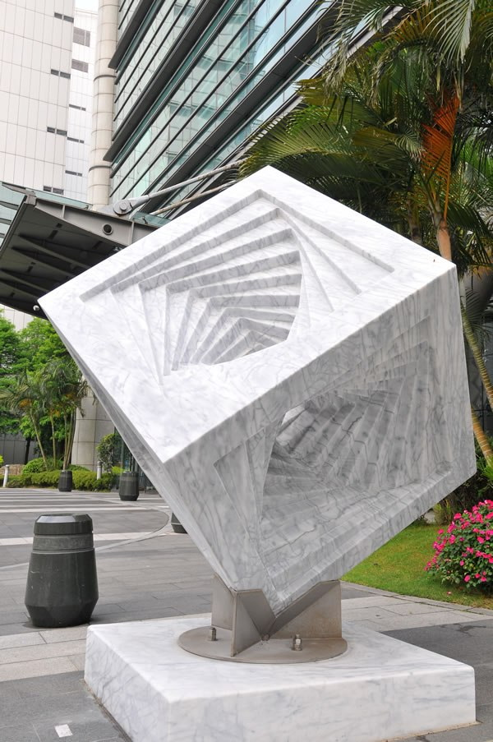
The Artists- Radoslav

Slide 28
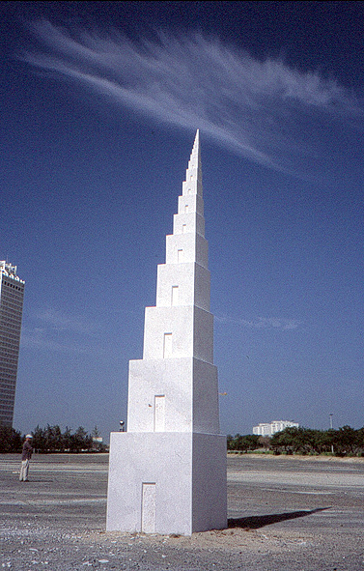
Be Part of the Sculpture Experience this Summer!
2012

Slide 29
References:
2011-2012 New Brunswick International Sculpture Symposium Inc.
http://www.sculpturesaintjohn.com/
1999-2012 Demand Media, Inc. http://www.ehow.com/how_2056491_carve-using-granite-stone.html#ixzz1vAtCQjLe
About Sara Branch:
Sara Branch is an elementary school teacher and a Masters in Education student. She created these slides as part of an independent study in Visual Literacy and Sculpture. It is hoped that this PowerPoint will provide audiences with some user friendly information about the symposium and the steps taken to carve granite.

